Slide 1
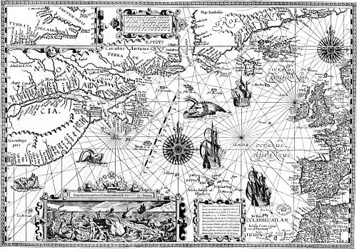
European Colonies
http://www.fromoldbooks.org/Holme-ArtInEngland/pages/114-Map-of-New-France/
A look at what a colony is, how it affected the First Nations and specifically; New France.

Slide 2
Important Definitions
Colony – a region claimed and governed by a country from another part of the world
Mercantilism – a regulated economic system that made a country rich from its colonies
http://knighttakesrook.blogspot.com/2011_01_01_archive.html

Slide 3
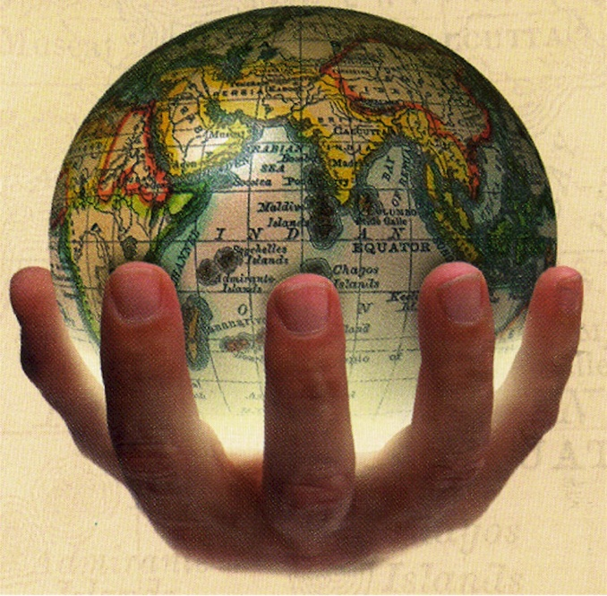
Colonies and imperialism: a match made in heaven!
Imperialism is a policy and an objective of a country, usually to take over control for financial/social gains
A colony is the proof of imperialism
http://www.europeword.com/blog/europe/european-imperialism/

Slide 4
Why European countries wanted colonies:
Gain new resources
Gain new land
Make money
Spread their religion and ideas
Which is economic imperialism? Which is social imperialism?

Slide 5
Mercantilism
http://openwalls.com/image?id=21653
How did it work?

Slide 6
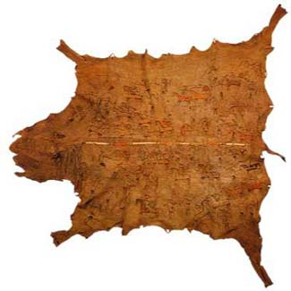
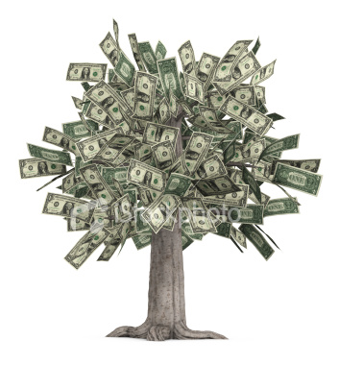
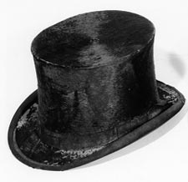
http://www.thelastbestwest.com/last_best_trading_post.htm
http://stories.washingtonhistory.org/leschi/closeties/fur-trading.htm
http://www.livingbueno.com/shift-your-mind/?currentPage=2

Slide 7
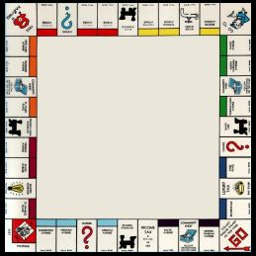
Monopoly
The complete control of a resource by a company
People would be granted charters by the king/queen and would claim land/resources in North America
Usually had to create settlements for the crown if granted a charter
http://www.bewersdorff-online.de/amonopoly/

Slide 8
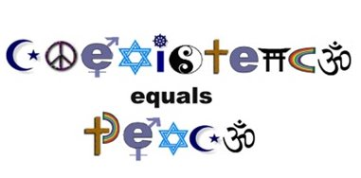
Coexistence
Two or more people of diverse cultures living together peacefully
What were the groups of people who were coexisting together?
http://arabadvertising.blogspot.com/2008/06/peace-is-coexistence.html

Slide 9
http://coursesite.uhcl.edu/HSH/Whitec/LITR/4231/default.htm

Slide 10
The Thirteen Colonies
Were mostly Protestant
First Nations conversion was not a high priority
There were 13 different colonies, each one having their own form of government
Britain appointed their governors
Made money through agriculture
The First Nations were viewed as obstacles; had to get them off the land or killed them as they were viewed as sub-human
http://www.dreamstime.com/stock-photo-construction-pylon-image950030

Slide 11
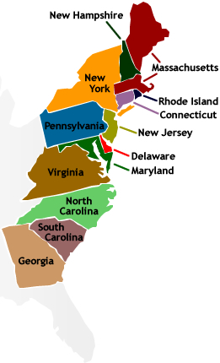
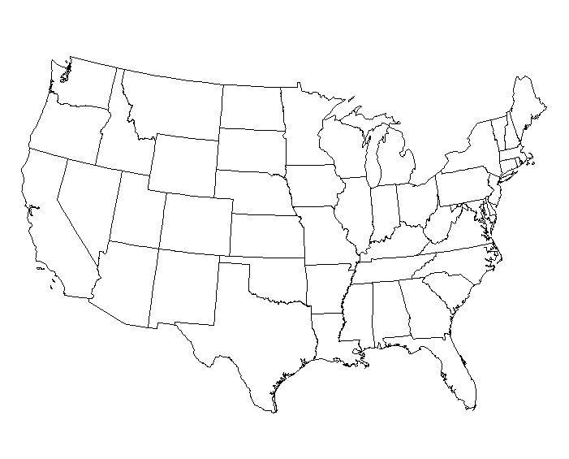
http://geography.about.com/library/blank/blxusa.htm
http://thebrightestman.wikispaces.com/UNIT%202%20--%20ARE%20WE%20IN%20INDIA%20YET,%20CHRIS?

Slide 12
Rupert’s Land
Had minimal population (no settlement was really built)
The few people there were mostly Protestant
This is where Britain had their fur trade (HBC)
Traders (British and First Nations) would come to them

Slide 13
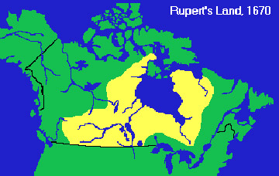
http://firstpeoplesofcanada.com/fp_metis/fp_metis1.html

Slide 14
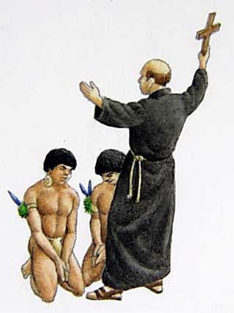
How were the First Nations impacted by these settlements?
Do you think the Europeans had
a right to bring their goods and
ideas to North America?
How did the Europeans ECONOMICALLY impact the First Nations?
http://historyrockscom.wordpress.com/2007/12/20/the-colonization-of-america/
How did the Europeans SOCIALLY impact the First Nations?
Think about the plays you did!

Slide 15
Immunity and Epidemics
First Nations had no immunity (ability to fight off infection and disease) to the European diseases
The diseases eventually became epidemics (when a large population gets infected)
Half the population can/did die
Created a massive population drop with the First Nations

Slide 16
Smallpox
Taken from www.dictionary.com
A highly infectious and often fatal disease caused by the variola virus of the genus Orthopoxvirus and characterized by fever, headache, and severely inflamed skin sores that result in extensive scarring. Once a dreaded killer of children that caused the deaths of millions of Native Americans after the arrival of European settlers in the Americas, smallpox was declared eradicated in 1980 following a worldwide vaccination campaign. Samples of the virus have been preserved in laboratories in the United States and Russia. Also called variola .

Slide 17
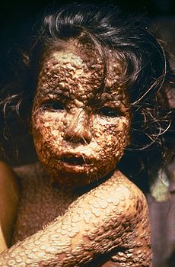
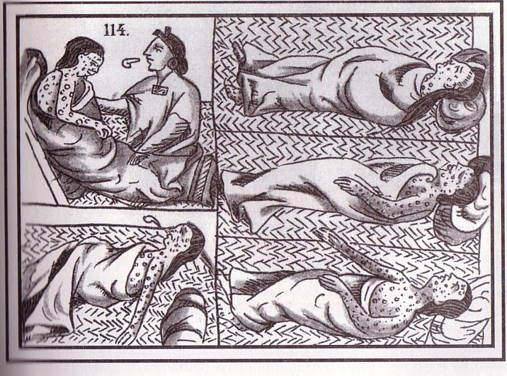
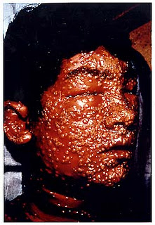
http://en.wikipedia.org/wiki/Smallpox
http://faculty.umf.maine.edu/walter.sargent/public.www/web%20230/virgin%20soil.html
http://atlasofdiseases.blogspot.com/2010/03/smallpox.html

Slide 18
Measles
Taken from www.dictionary.com:
An infectious disease caused by the rubeola virus of the genus Morbillivirus , characterized by fever, cough, and a rash that begins on the face and spreads to other parts of the body. Vaccinations, usually given in early childhood, confer immunity to measles. Also called rubeola .

Slide 19
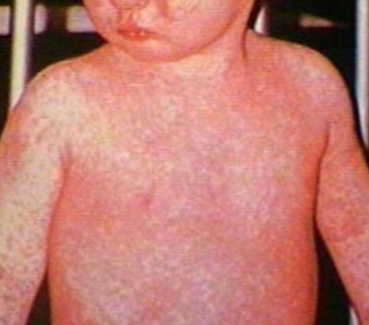
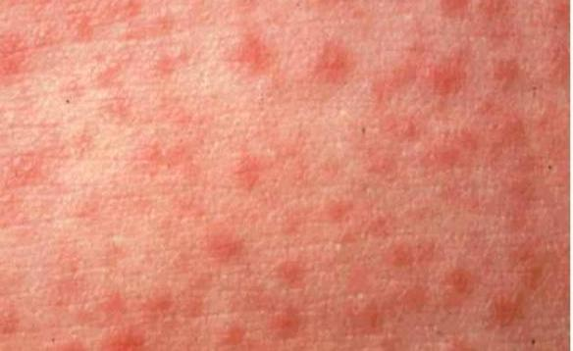
http://www.medicalook.com
http://topnews.net.nz/content/22964-measles-breaks-out-hokianga-district/Infectious_diseases/Measles.html

Slide 20
Tuberculosis
Taken from www.dictionary.com:
An infectuous disease caused by the bacterium Mycobacterium tuberculosis that is transmitted through inhalation and is characterized by cough, fever, shortness of breath, weight loss, and the appearance of inflammatory substances and tubercles in the lungs. Tuberculosis is highly contagious and can spread to other parts of the body, especially in people with weakened immune systems. Although the incidence of the disease has declined since the introduction of antibiotic treatment in the 1950's, it is still a major public-health problem throughout the world, especially in Asia and Africa.

Slide 21
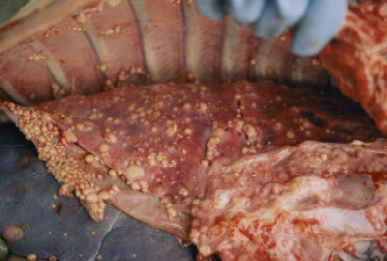
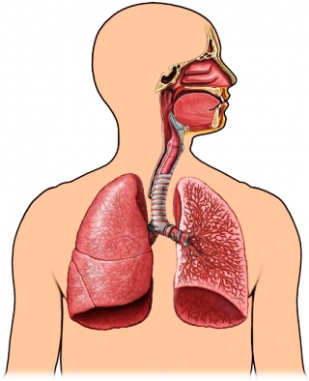
http://www.michigan.gov/emergingdiseases/0,4579,7-186-25804-76392--,00.html
http://www.empowher.com/condition/tuberculosis/causes

Slide 22
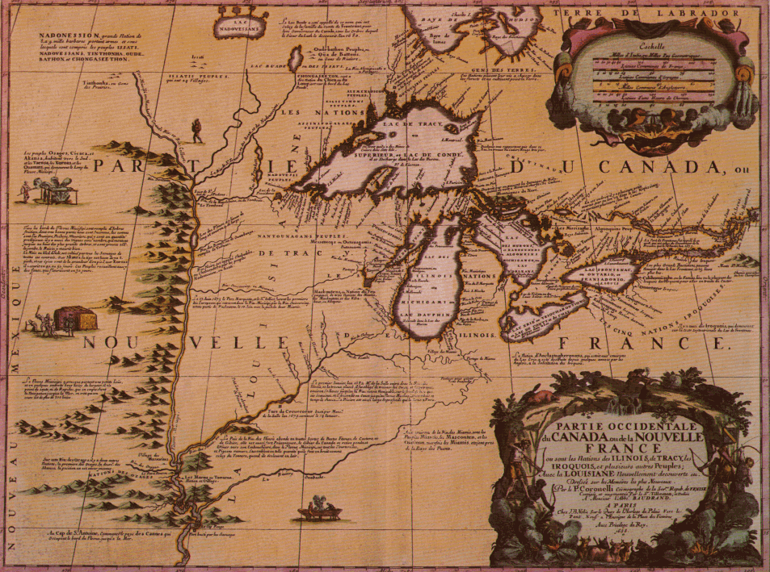
New France
http://colonialhistoryofcanada.blogspot.com/2011/06/not-all-about-land-fishing-and-property.html
An in-depth look

Slide 23
General Information
Very, very, very, very, very (is that enough emphasis) religious: Catholic
Thought that it was their duty to get more followers, so conversion of the First Nations was a top priority
New France started because of merchant monopolies on the fur trade
France eventually took full control and started sending people to New France
Relied on relationships with the First Nations

Slide 24
Hierarchy
Had a society based system that was divided by rank
One was born into their class
The King of France was always at the top of the hierarchy
Usually there are more people in the lower ranks, and less people in the higher ranks
Most people were farmers
Because religion was very important, the Catholic Church was influential and near the top of the hierarchy

Slide 25
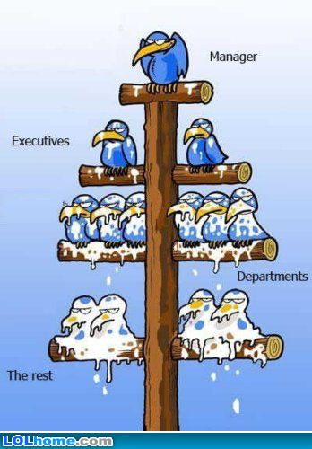
Roles and ranks in the hierarchy of New France
You will have many questions on your test about these….

Slide 26
The Sovereign Council
Was established by the King of France, this council is what ruled New France
Governor – represented the King
Controlled the military
Defended the colony
Dealt with any outside people (First Nations, France, etc)

Slide 27
Sovereign Council Continued
Intendant – worked for France
Was one of the main controllers of the colony
Made sure everything was working well and tried to make the colony meet their own needs without having to look to France
Looked to see how France could use the colony to make more money
Bishop of Quebec – Was the Catholic Church’s representative
Helped the people and helped solidify the colony by building schools, hospitals and orphanages
Would help govern the colony (were a strong influence on politics)
Everyone’s reputation depended on his/her standing within the Church

Slide 28
Soldiers
Were sent to defend New France from imposing threats (British, Haudenosaunee)
Officers were given seigneuries (will be explained later) in hopes that they would stay (settle) after the fighting stopped
Soldiers would often settle on their officer’s lands
Gave the soldiers something to do after their military service (was also great for New France to have trained military professionals living in the colony)

Slide 29
Seigneuries
Large plots of land/farms owned by seigneurs
Were arranged so habitants had access to the river
Why do you think having access to water is important?

Slide 30
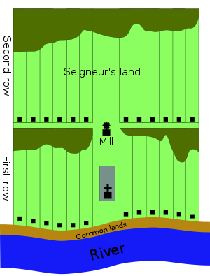
http://en.wikipedia.org/wiki/Seigneurial_system_of_New_France

Slide 31
Habitants and Seigneurs
Habitants were farmers who lived in seigneur’s land which are called seigneuries
Seigneurs received the land from the King
Had to recruit people to the land themselves
Had to build a house, a flour mill, and a church on the land
Habitants were considered the “peasants” of New France
Had the clear the land, plant crops, and build a house
Land was sometimes neglected because people entered the fur trade which made them more $$$

Slide 32
Catholic Church and Clergy
Basically made the identity of New France
The Jesuits were the religious order who came from France
Established missions with the First Nation’s communities to convert them
Most were educated
Established schools, hospitals, orphanages
Because they were educated and the church was very important, they helped out with political decisions

Slide 33
Fur Trade
Jobs they would have!
http://firstpeoplesofcanada.com/fp_groups/fp_groups_travel.html

Slide 34
Coureur de Bois
Means runner of the woods
Worked for themselves and used their relationships with First Nations
Would trap/trade beaver pelts for the fur trade
Did whatever they could to get money, even sell furs to the British
Eventually their independent trading style became illegal, many still kept trading

Slide 35
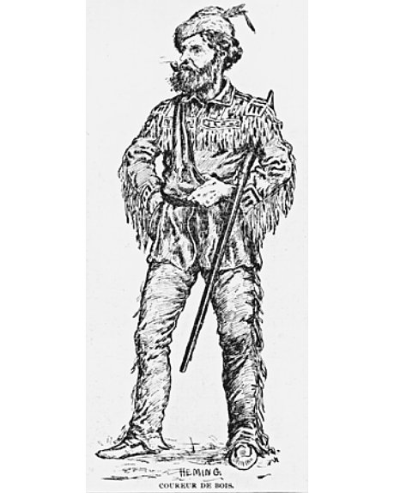
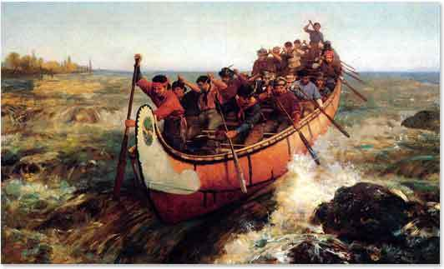
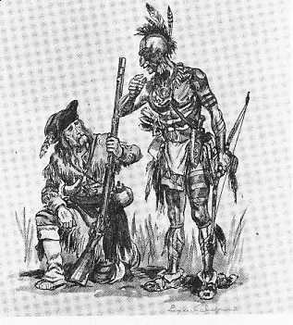
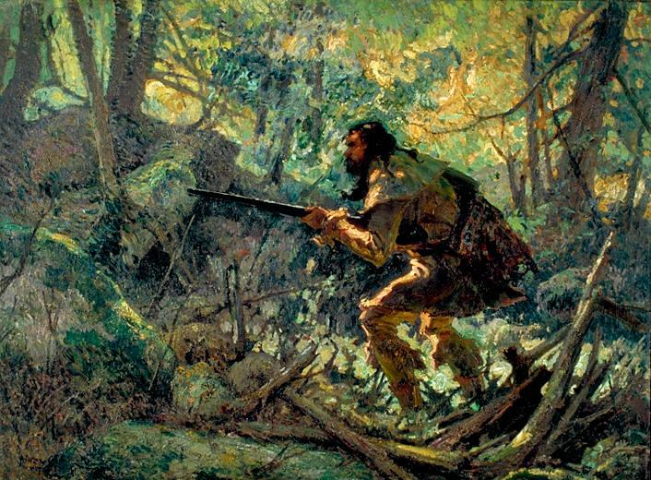
http://en.wikipedia.org/wiki/File:Coureur_de_bois.jpg
http://www.dipity.com/coni7983/NEW-FRANCE/
http://popartmachine.com/item/pop_art/NGC-NGC_.28179/MARC-AUR
http://www.uppercanadahistory.ca/finna/finna5a.html

Slide 36
Merchants
Were the people who owned the shops
Blacksmiths, shoemakers, masons, bakers, butchers, etc.
Made lots of money in the fur trade
Since the First Nations did not use currency, they would trade goods for furs
These are the people who would import the goods needed to trade
After getting the furs, they would export them to France

Slide 37
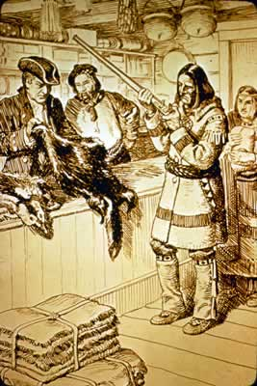
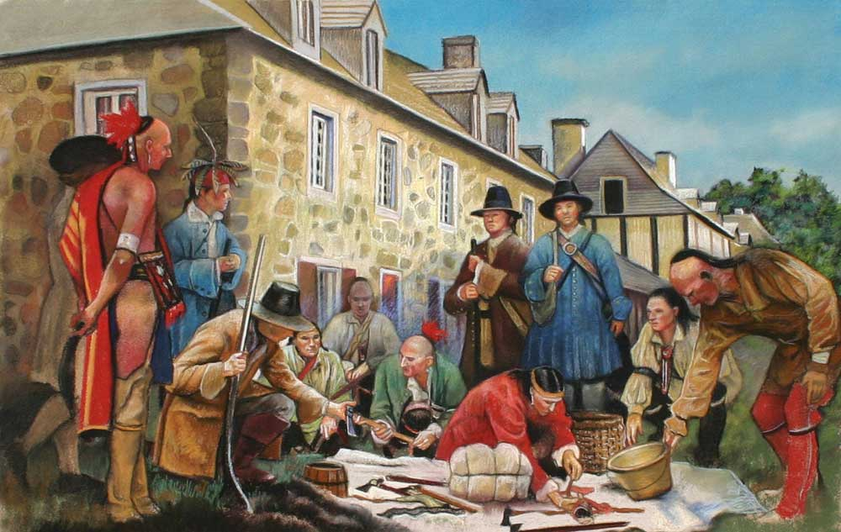
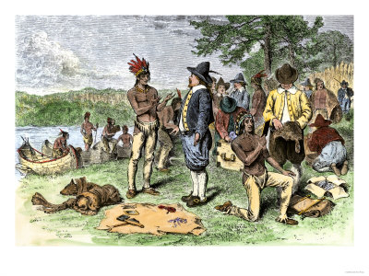
http://www.pkwy.k12.mo.us/west/teachers/boles/student_work/west_web5/cathyk.htm
http://schenectadyhist.wordpress.com/page/2/
http://maddiesancestorsearch.blogspot.com/2011/06/1690-schenectady-ny-massacre.html

Slide 38
Voyageur
Means traveller
Travelled between merchants (in town) and the trading posts
As they are called the travellers, they are the ones who made their way out West

